Slide 1
Traffic Violation Detection System
Project Presentation

Slide 2
Introduction
This project focuses on developing a Traffic Violation Detection System using machine learning.
It involves data preprocessing, training a classification model, and integrating it with an application.

Slide 3
Problem Statement
Define traffic violation detection as the problem.
Importance: reduce accidents, improve law enforcement, smarter traffic management.

Slide 4
Dataset
Dataset: traffic_violations_dataset.csv
Contains traffic violation records
Used for training and testing
Features: type of violation, location, time, etc.
Target: Violation category

Slide 5
Methodology
Data Collection (CSV dataset)
Data Preprocessing (cleaning & encoding)
Model Training (using ML algorithms)
Model Saving (traffic_violation_model.pkl)
Integration into Application (app.py)
Testing and Evaluation

Slide 6
Dataset Description
Source: traffic_violations_dataset.csv
Features: Driver Age, Violation Type, Vehicle Type, Location, Fine Amount
Target: Violation category

Slide 7
EDA Findings (with visuals)
Distribution of driver age (histogram)
Counts of violation types (bar chart)
Boxplot of fine amount vs violation type
Correlation heatmap

Slide 8
Feature Engineering
Encoding categorical variables (Violation, Vehicle, Location)
Scaling numerical values (Driver_Age, Fine_Amount)
Handling missing values (checked, imputed/removed if any

Slide 9
Model Building & Evaluation
Algorithm: Random Forest Classifier (100 estimators)
Data split: 80% train, 20% test
Evaluation metrics: Accuracy, Precision, Recall, F1-score
Confusion matrix

Slide 10
Model Deployment
Saved model as traffic_violation_model.pkl
Deployment with Flask/Streamlit for real-time predictions
Screenshot placeholder for app UI

Slide 11
Steps in Coding
1. Import necessary libraries (pandas, sklearn, flask, etc.)
2. Load dataset and preprocess it
3. Train machine learning model
4. Save trained model as .pkl file
5. Create Flask app (app.py) for predictions
6. Deploy and test system

Slide 12
Results
- Successfully trained ML model
- Model saved as traffic_violation_model.pkl
- Application developed for prediction
- System helps in traffic violation detection

Slide 13
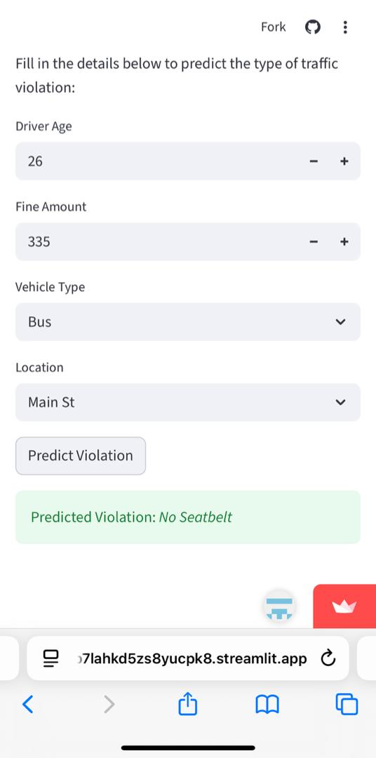
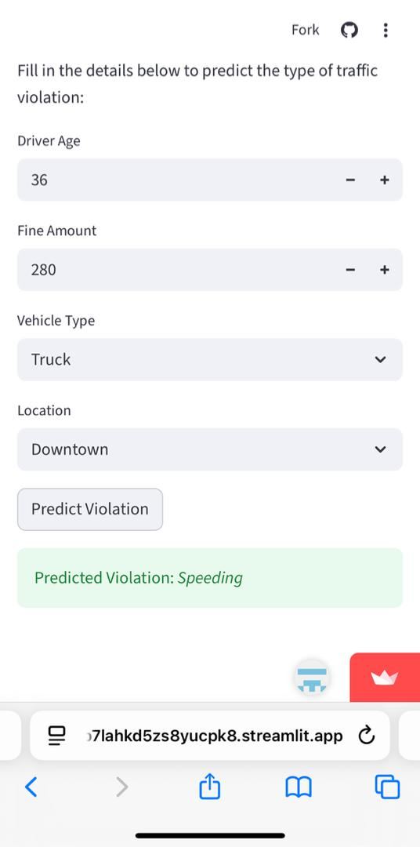
Screenshots

Slide 14
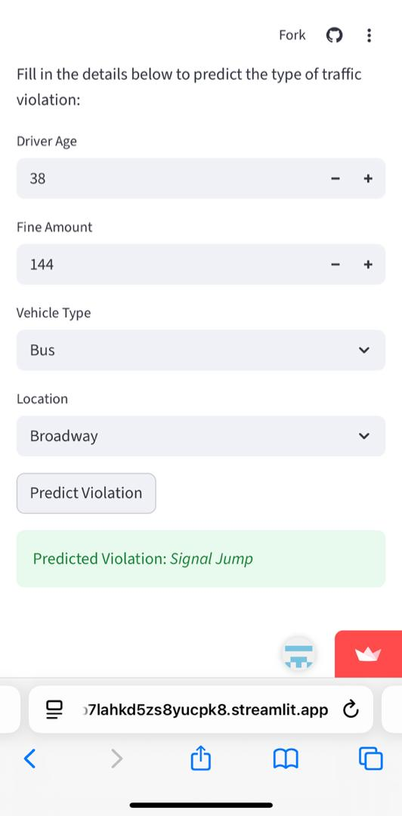
Screenshots

Slide 15
Conclusion
The Traffic Violation Detection System demonstrates the use of machine learning in improving traffic safety.
By automating detection, it provides a step towards smart traffic management systems.
Future work can focus on real-time image/video processing.

